Slide 1
Deconvoluting Convolutions
Data Science Meetup
April 2018

Slide 2

Topics
The 2018 Data Science Bowl
Puppy bowl
Image processing basics
The simple approach
Superbowl
Feature detection basics
The U-Net approach
Performance

Slide 3
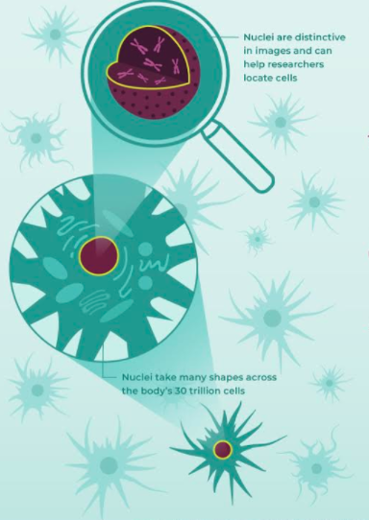


Slide 4
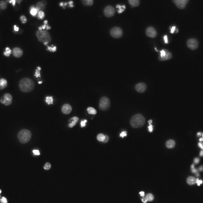
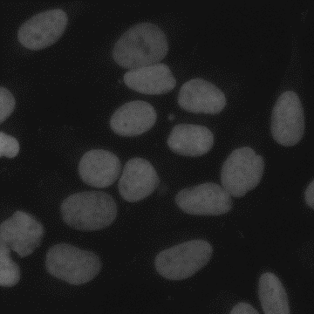
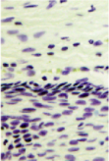
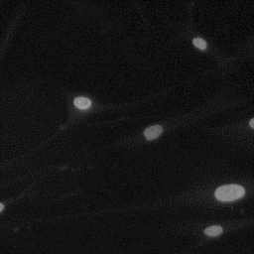
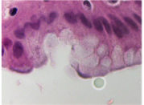
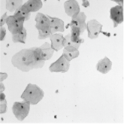
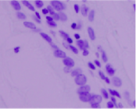

Slide 5
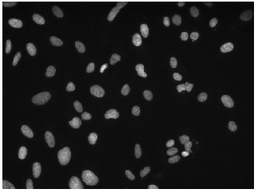
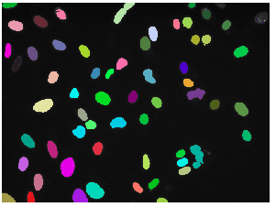
Competition goal:
Separate mask for each nucleus
Competition metric:
Intersection of the Union

Slide 6
Competition challenges
Variety of colors, microscopy types
Variety of sizes and scales
Different background tissue / nuclei types
**Overlapping nuclei**
Small training set (~700)
Errors in training set

Slide 7
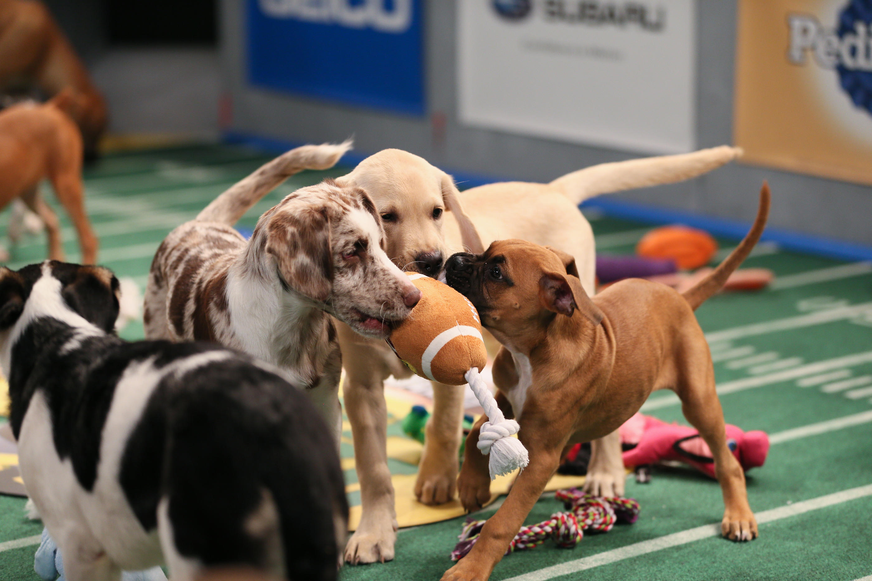
Topics
The 2018 Data Science Bowl
Puppy bowl
Image processing basics
The simple approach
Superbowl
Feature detection basics
The U-Net approach
Performance

Slide 8
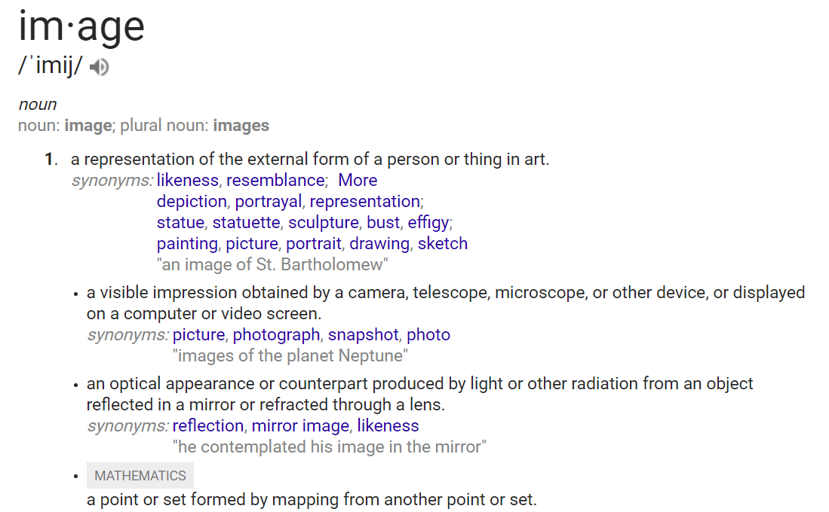

Slide 9
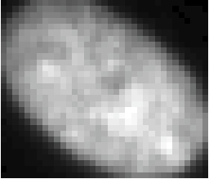
Image: Intensity data with meaningful order
One cell from train image

Slide 10
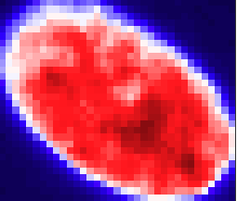
Image: Intensity data with meaningful order
One cell from train image
Data with 3 color channels

Slide 11
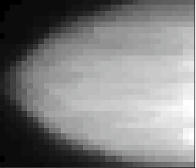
Image: Intensity data with meaningful order
One cell from train image
Data sorted along rows

Slide 12

Types of image analyses

Slide 13
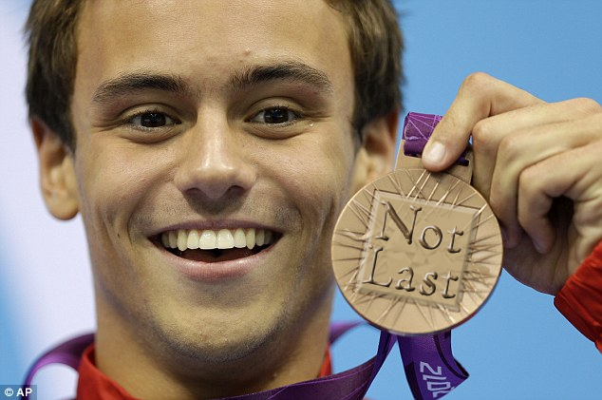
Topics
The 2018 Data Science Bowl
Puppy bowl
Image processing basics
The simple approach
Superbowl
Feature detection basics
The U-Net approach
Performance

Slide 14
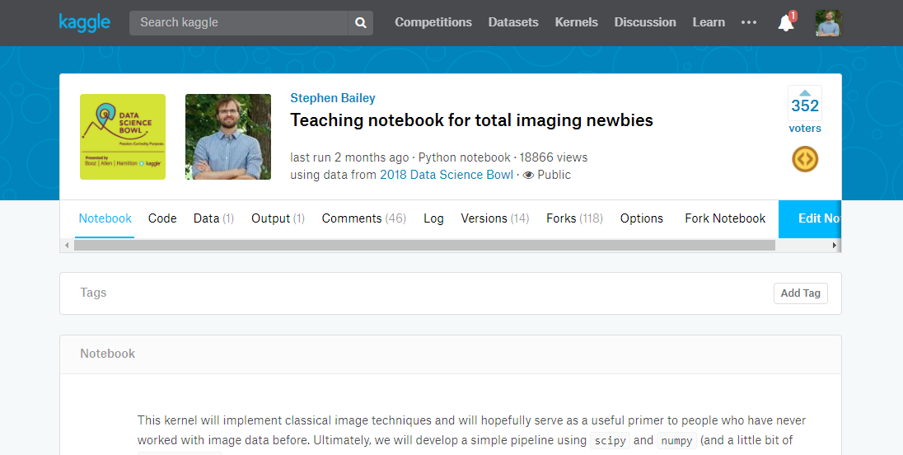
The dumb approach

Slide 15
Competition challenges
Small training set (~700)
Variety of colors, microscopy types
Variety of sizes and scales
Different background tissue
Overlapping nuclei

Slide 16
Competition challenges
Small training set (~700)
Variety of colors, microscopy types
Variety of sizes and scales
Different background tissue
Overlapping nuclei

Slide 17
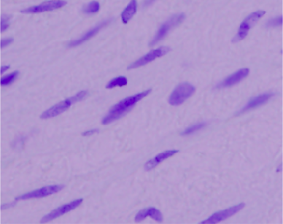
Step one: Convert to grayscale image.

Slide 18
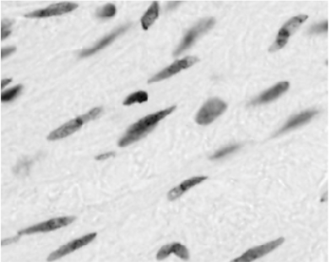
Step one: Convert to grayscale image.

Slide 19
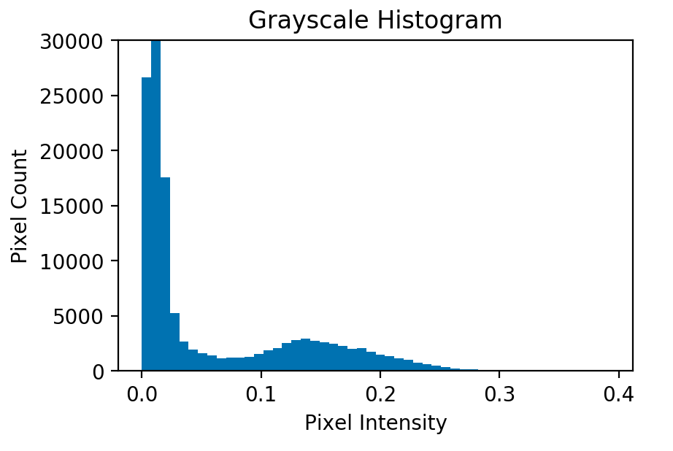
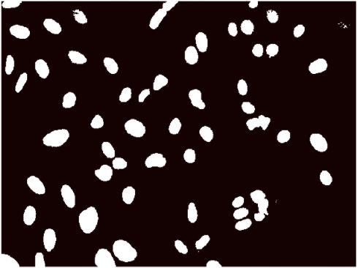
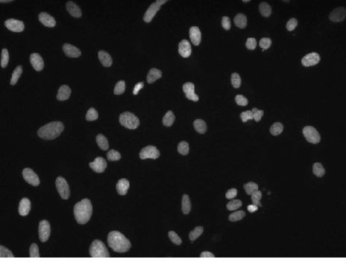
Step two: Threshold background
Assume there are two pixel types in the image:
Nuclei
Background.

Slide 20
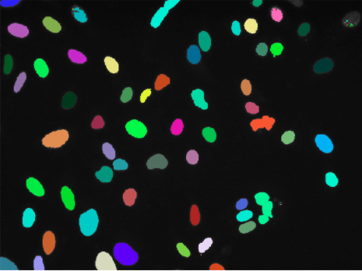
Step three: Separate individual objects

Slide 21
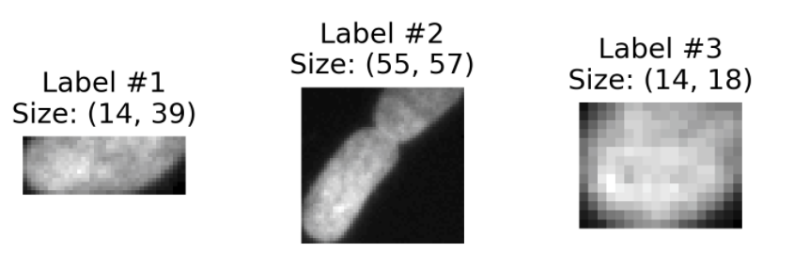
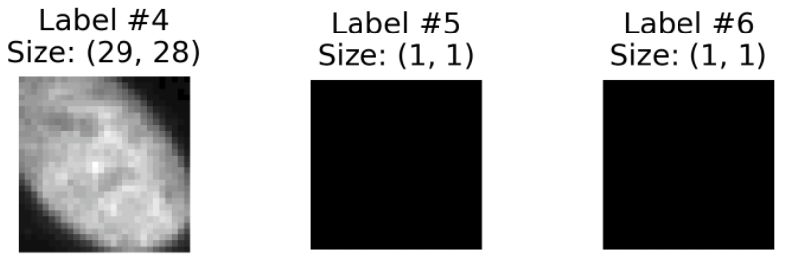
Step four: Post-process individual objects
Eliminate tiny objects

Slide 22
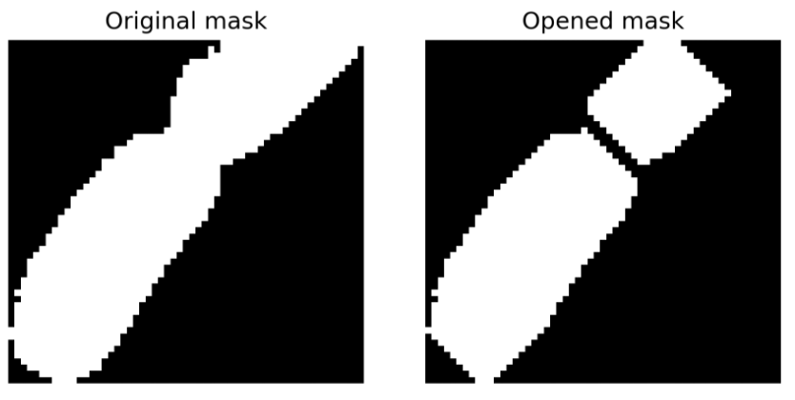
Step four: Post-process individual objects
Eliminate tiny objects
Open connected objects

Slide 23
Step five: Encode and submit
[Scores Censored by Kaggle]

Slide 24
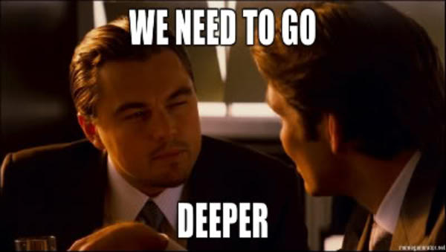

Slide 25
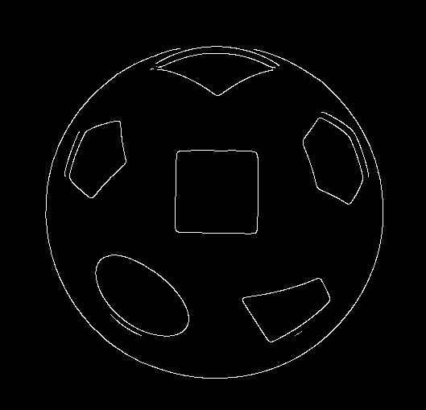
Topics
The 2018 Data Science Bowl
Puppy bowl
Image processing basics
The simple approach
Superbowl
Feature detection basics
The U-Net approach
Performance

Slide 26
Humans recognize objects from patterns
Ratios
Edges
Color

Slide 27
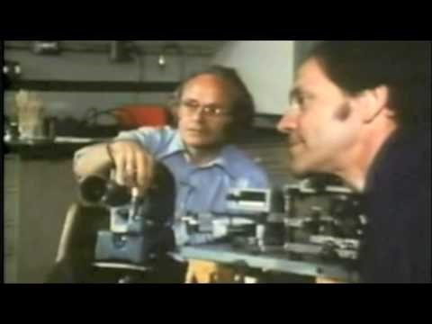
https://www.youtube.com/watch?v=IOHayh06LJ4

Slide 28
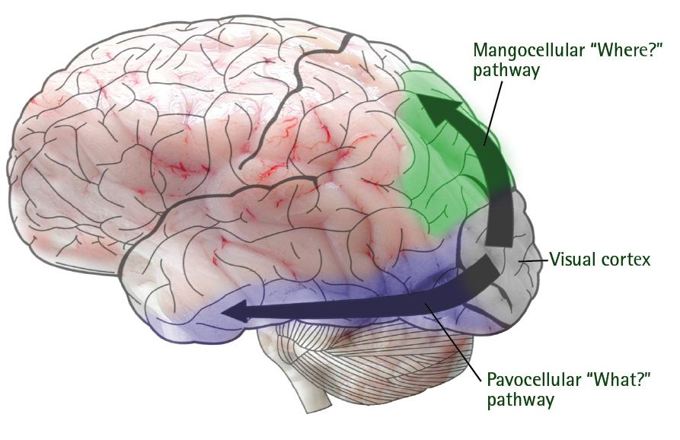
https://aspergerhuman.wordpress.com/

Slide 29
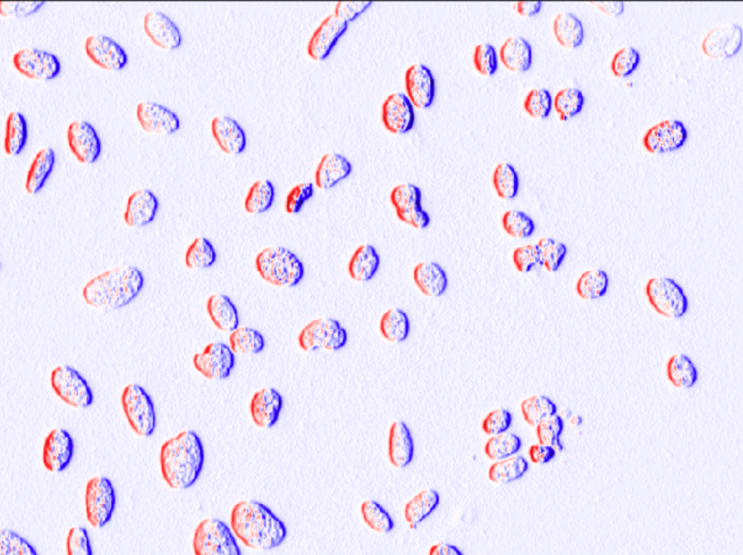
Convolution: Weighting an image by a pattern.
Horizontal Edges
3 x 3
1 | 0 | -1
1 | 0 | -1
1 | 0 | -1

Slide 30
Convolution sums the element-wise product of an image window and filter
Image Window
Filter
5 · 1
5 · 1
5 · 1
4 · 0
4 · 0
4 · 0
3 · -1
3 · -1
3 · -1
5 | 4 | 3
5 | 4 | 3
5 | 4 | 3
1 | 0 | -1
1 | 0 | -1
1 | 0 | -1
*
=
SUM
=
6

Slide 31
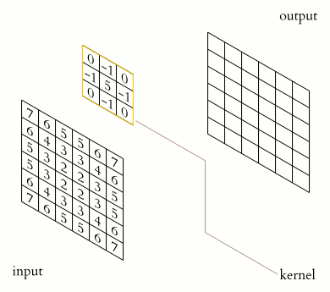
A separate convolution is performed for each pixel.

Slide 32

A separate convolution is performed for each pixel.

Slide 33
Results: Horizontal Edges
1 | 0 | -1
1 | 0 | -1
1 | 0 | -1

Slide 34
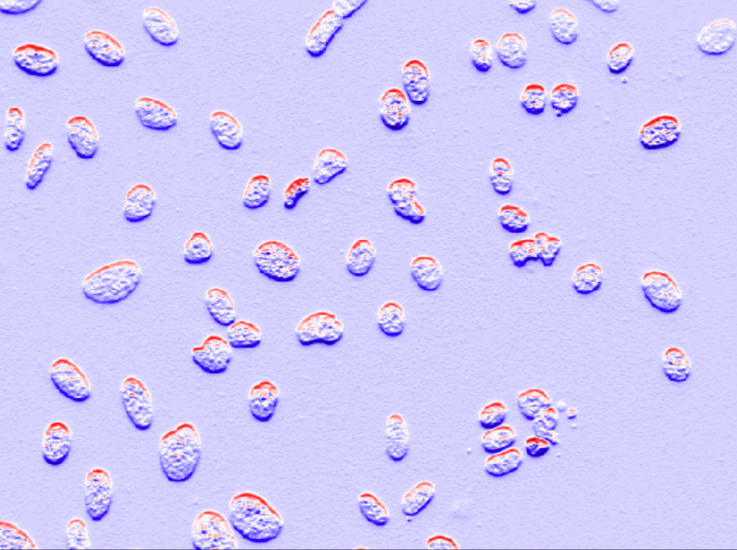
Results: Vertical Edges
1 | 1 | 1
0 | 0 | 0
-1 | -1 | -1

Slide 35
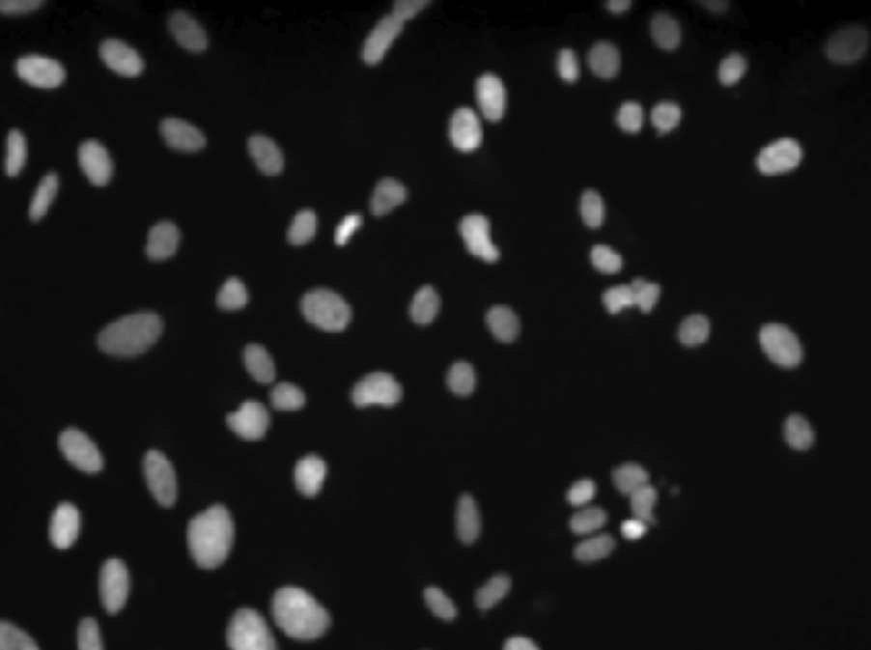
Results: Mean Filter
1 | 1 | 1
1 | 1 | 1
1 | 1 | 1

Slide 36

Convolve image with multiple filters

Slide 37
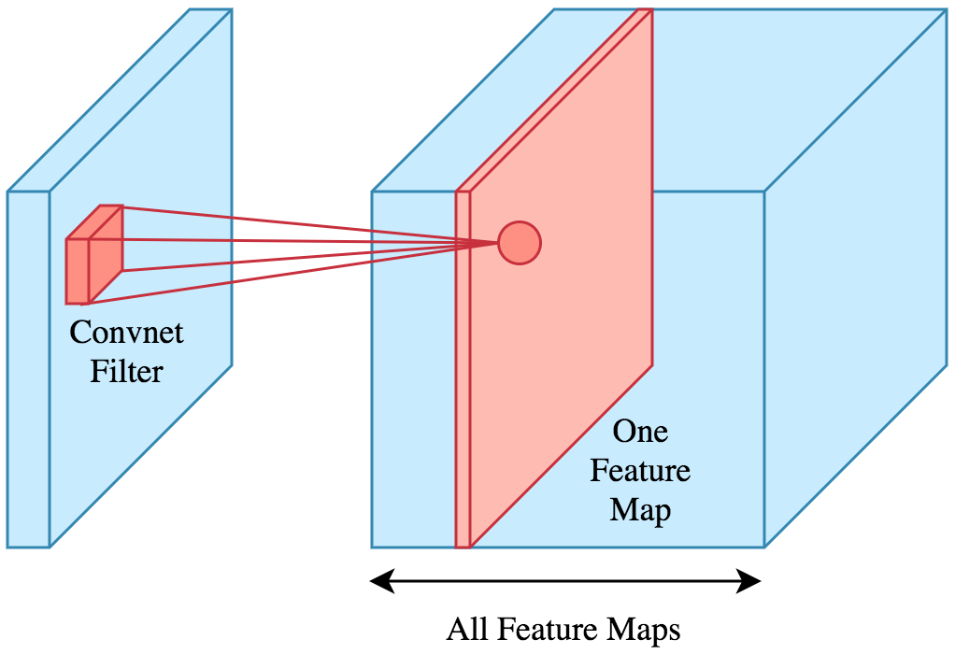
Convolve image with many filters
Horiz. edges
Vert. edges
Diag. edges
Flat areas
Smooth areas
High color
…
Change in # channels
https://www.kdnuggets.com/

Slide 38
Convolutional neural networks
Don’t impose filter weights… learn them!
Horizontal Edges
3 x 3
Conv2D Weights [0]
3 x 3
1 | 0 | -1
1 | 0 | -1
1 | 0 | -1
1.2 | -0.3 | -1.3
1.8 | 0.1 | -1.6
1.1 | 0.2 | -0.4

Slide 39
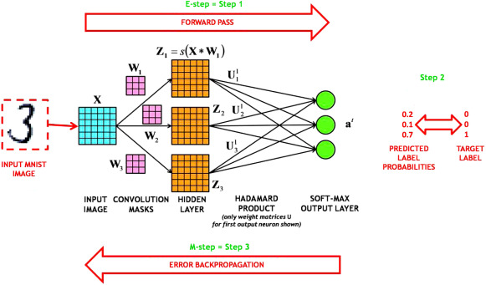
Forward Propagation
Cost Computation
Backward Propagation

Slide 40
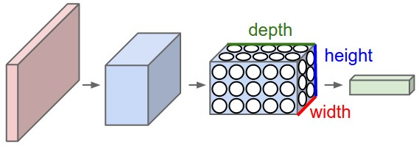
Rule of thumb: Layers get more compact but deeper.

Slide 41
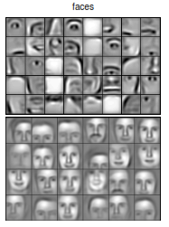
Rule of thumb: Filters become sensitive to higher level features in deeper layers
Layer 2
Layer 3
www.chioka.in

Slide 42
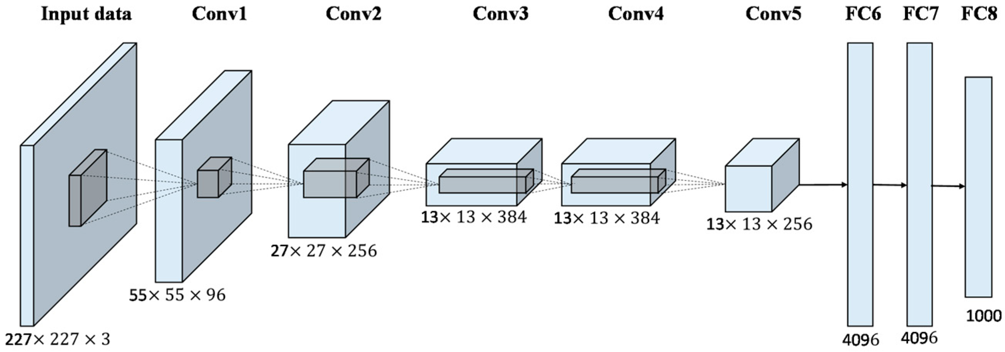
Rule of thumb: Use a pre-built architecture
https://medium.com/

Slide 43
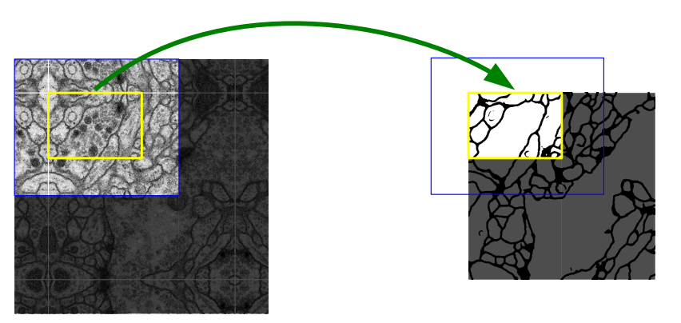

Topics
The 2018 Data Science Bowl
Puppy bowl
Image processing basics
The simple approach
Superbowl
Feature detection basics
The U-Net approach
Performance
Ronneberger et al., 2015

Slide 44

The U-Net
The U-Net
Skip connection
Contraction
Expansion
Ronneberger et al., 2015

Slide 45
Layer Types
Convolutions
3 x 3 Filter Size
“Valid” padding
Max Pooling
Up-convolutions
Skip Connections
https://www.oreilly.com/

Slide 46
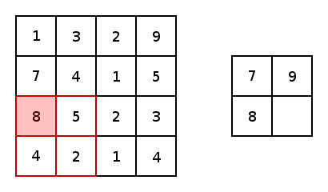
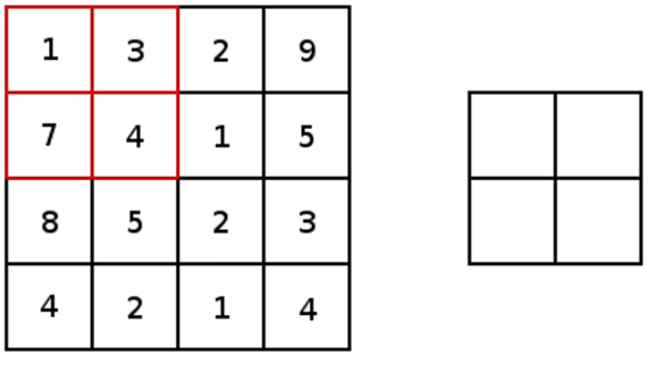
Layer Types
Convolutions
3 x 3 Filter Size
“Valid” padding
Max Pooling
Up-convolutions
Skip Connections
https://www.oreilly.com/

Slide 47
Layer Types
Convolutions
3 x 3 Filter Size
“Valid” padding
Max Pooling
Up-convolutions
Skip Connections
https://www.oreilly.com/

Slide 48
Convolutions change depth, Pooling changes height / width
https://medium.com/

Slide 49

Layer Types
Convolutions
3 x 3 Filter Size
“Valid” padding
Max Pooling
Up-convolutions
Skip Connections
https://github.com/vdumoulin/conv_arithmetic

Slide 50
Contraction Path
Layer | Area | Depth
Input | 572² | 1
Conv1 | 570² | 64
Conv2 | 568² | 64
MaxPool1 | 284² | 64
Conv3 | 282² | 128
Conv4 | 280² | 128
MaxPool2 | 140² | 128

Slide 51
Basin
Layer | Area | Depth
MaxPool4 | 32² | 512
Conv9 | 30² | 1024
Conv10 | 28² | 1024
UpConv1 | 56² | 512

Slide 52
Expansion Path
Layer | Area | Depth
UpConv3 | 200² | 256
Conv15 | 198² | 128
Conv16 | 196² | 128
UpConv4 | 392² | 128
Conv17 | 390² | 64
Conv18 | 388² | 64
Output | 388² | 2

Slide 53
Skip Connections
Crops and copies information from earlier in the network to deeper layers
Allows final resolution to remain high

Slide 54
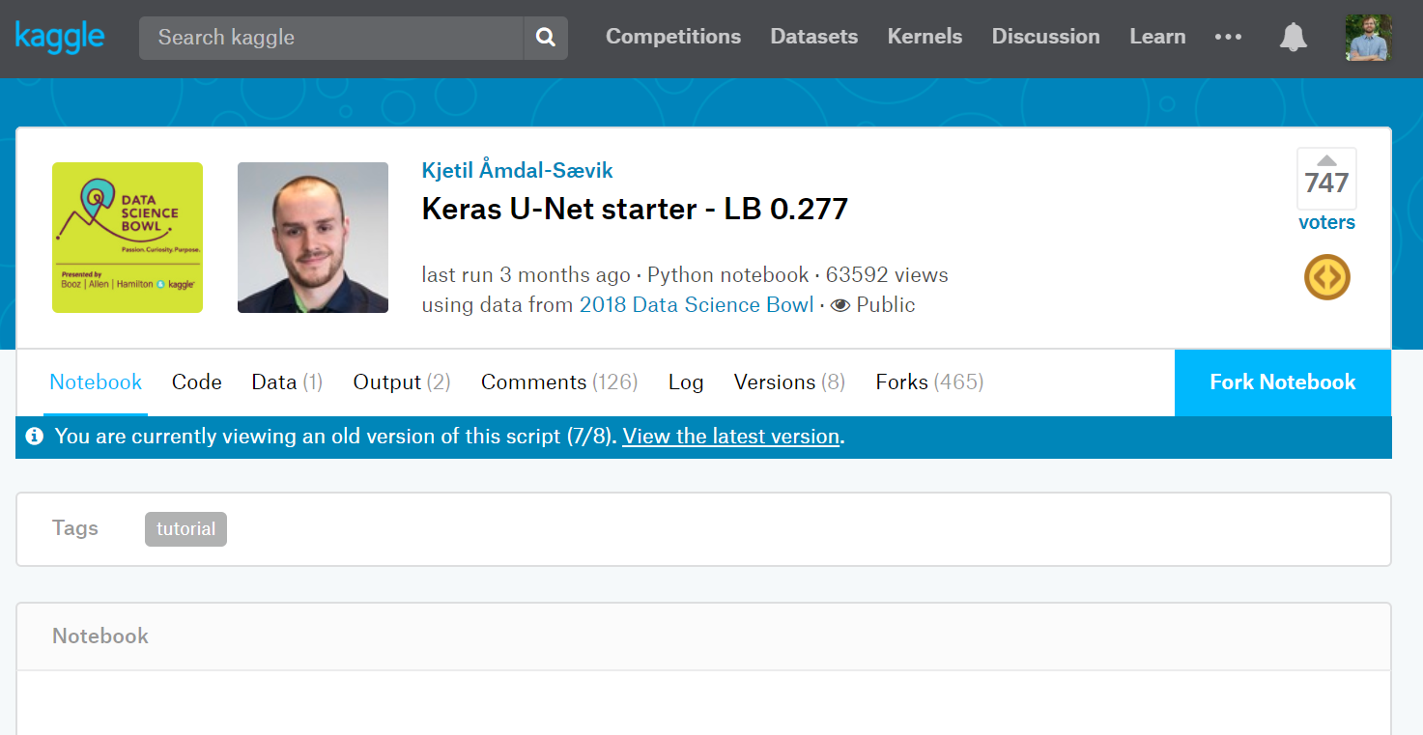

Slide 55
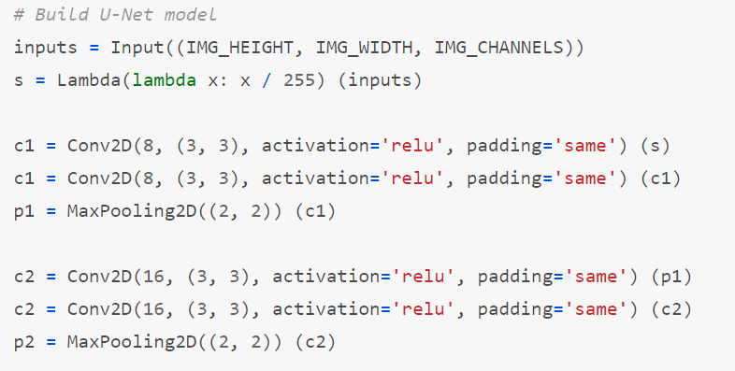

Slide 56
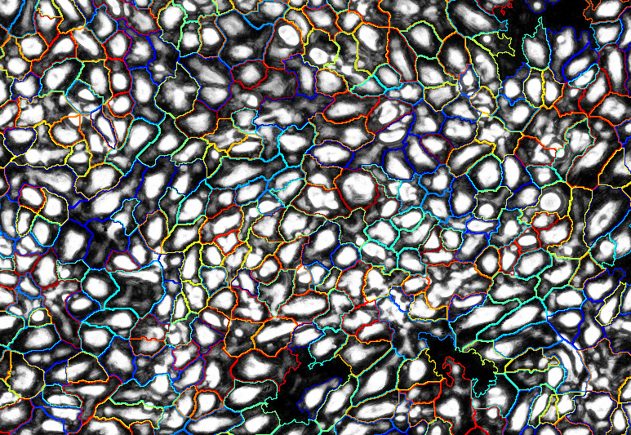
Topics
The 2018 Data Science Bowl
Puppy bowl
Image processing basics
The simple approach
Superbowl
Feature detection basics
The U-Net approach
Performance

Slide 57
Model performance (0.0 – 0.6)
Approach Mean Average Precision
Vanilla image processing 0.20 – 0.28
Vanilla U-Net 0.25 – 0.42
Vanilla Mask R-CNN 0.37 – 0.50
U-Net + Deep Watershed 0.45 – 0.55
Winning model ~ 0.65

Slide 58
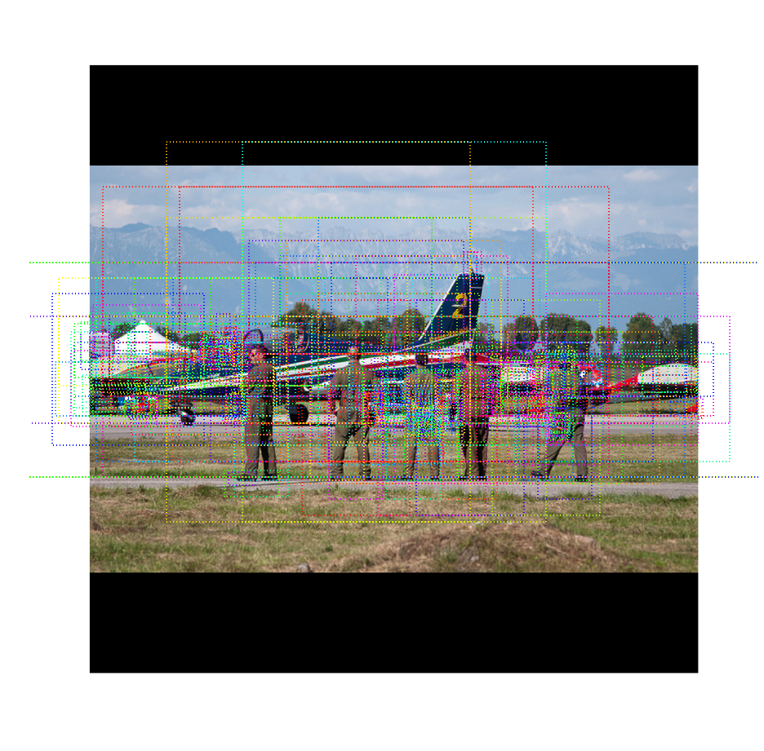
Mask R-CNN
Region Proposal Network detects “candidate” areas
Areas are refined by removing overlapping bounding boxes
Data from each box is extracted and segmentation is run
Different components re-combined into single evaluation image
Step 1 of R-CNN
https://github.com/matterport/Mask_RCNN

Slide 59
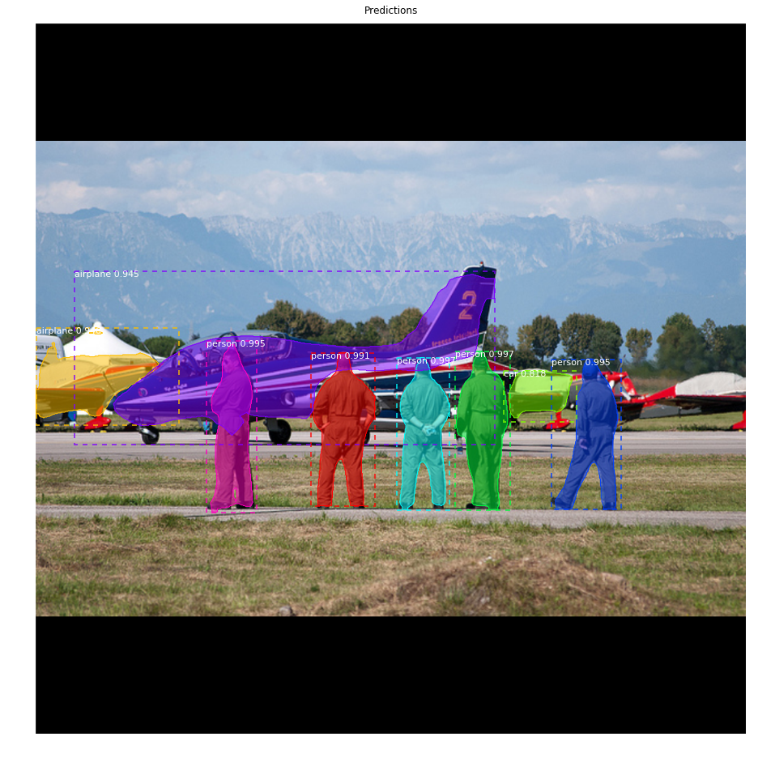
Mask R-CNN
Region Proposal Network detects “candidate” areas
Areas are refined by removing overlapping bounding boxes
Data from each box is extracted and segmentation is run
Different components re-combined into single evaluation image
Step 4 of R-CNN
https://github.com/matterport/Mask_RCNN

Slide 60
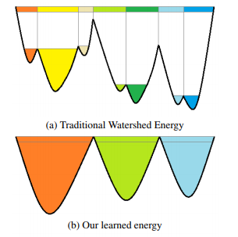
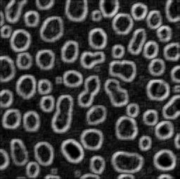
Watershed Transform

Slide 61
Insight 1: Data augmentation is critical.
Add gaussian noise
Color to gray
Contrast and brightness
Random crop
Mosaics
Random rotate

Slide 62
Insight 2: Neural networks don’t do it all.
Output of models was treated as “candidate nuclei”… still need to post-process data!
e.g., Use morphological features such as solidity, circularity, convexity, area, neighbors median, count, etc. to calculate “predicted IOU” for each mask.

Slide 63
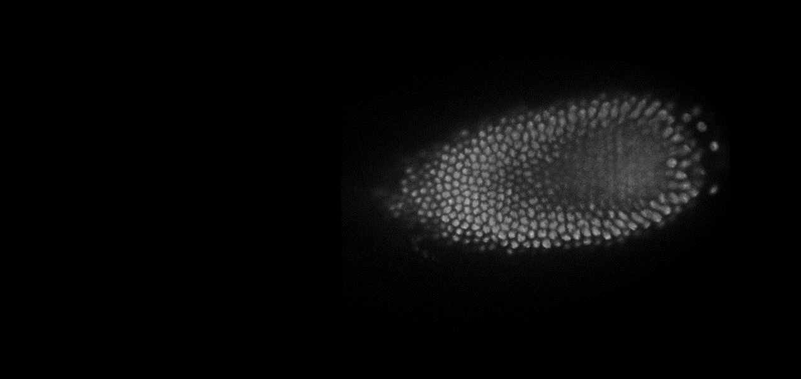
Insight 3: Pick the right target…

Slide 64

Insight 3: Pick the right target…
Predict borders, not cells

Slide 65

Insight 3: Pick the right target…

Slide 66


Slide 67
For further reference…
Coursera’s Deep learning specialization
“U-Net: Convolutional Networks for Biomedical Image Segmentation” by Ronneberger, Fischer and Brox
Kaggle’s Data Science Bowl 2018
1st Place Solution from ods.ai
4th Place U-Net + Watershed from Nuclear Vision
11th Place Open Solution from Zheng Li

